Slide 1
Length

Slide 2










Let us go to a distance x and take small element dx
$$dl=$$
$$dx$$
$$x$$
$$dx$$
$$Rdθ$$
Let us go to an angle $θ$ and take small element $dθ$
$$dθ$$
$$dl=$$
$$Rdθ$$
$$θ$$
$$R$$

Slide 3
THE END
for Most Basic questions

Slide 4
Area

Slide 5











$$θ$$
$$x$$
$$dx$$
$$x$$
$$dx$$
$$x$$
$$dx$$
$$dA=y∗dx$$
$$dA=height∗dx$$
$$dA=y∗dx$$
$$tanθ=\frac{y}{x}$$

Slide 6

















Some variation in radius
Some variation in x
Some variation in $θ$
$$dr$$
$$Rdθ$$
$$dθ$$
$$r$$
$$θ$$
$$x$$
$$2πr$$
$$dx$$
$$dr$$
$$dA=$$
$$2πr∗dr$$
$$dA=$$
$$2y∗dx$$
$$\frac{1}{2}R∗Rdθ$$
$$dA=$$
$Note:$ Convert y into x
: Or convert y, x into angle

Slide 7










IF need to include edge point
$$90$$
$$dA=$$
$$r∗2θ$$
$$∗dr$$
$$r$$
$$−90$$
$$θ$$
$$2R$$

Slide 8














Sphere
$$r$$
$$Rdθ$$
$$⇒dA$$
$$=2πr$$
$$×$$
$$Rdθ$$
$$⇒r$$
$$=Rsinθ$$
$$dθ$$
$$⇒Angle range$$
$$=0° to 180°$$
$$θ$$

Slide 9







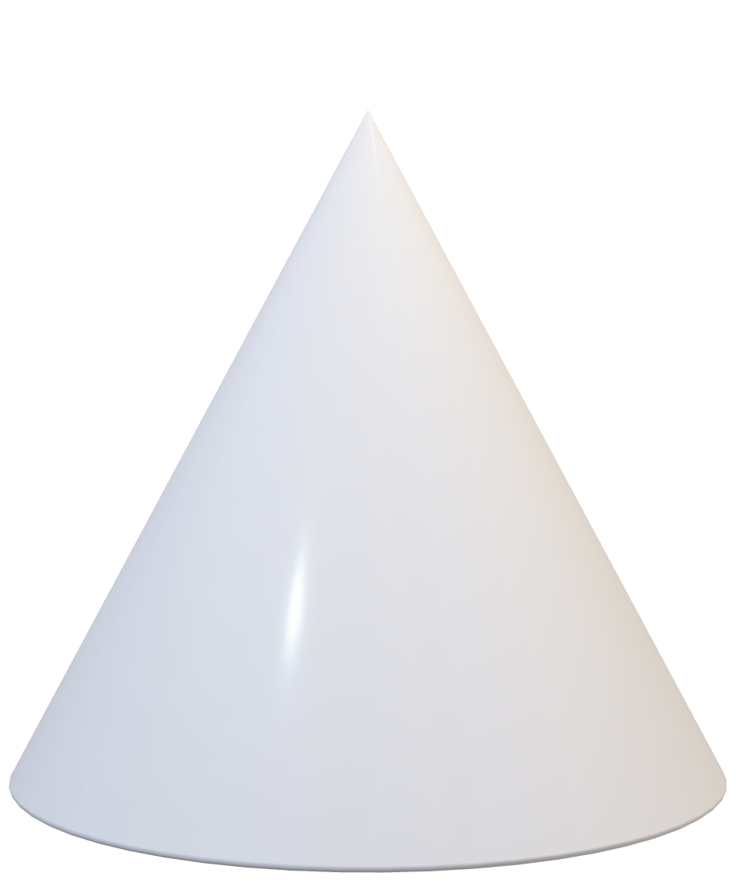




Cone : Area
$$dl$$
$$dA=$$
$$2πr$$
$$∗$$
$$dl$$
$$l$$
$$r$$
Convert $x,r$ and $l$ into single variable
$$x$$
$$dx$$

Slide 10
Volume

Slide 11





Cylinder Volume
$$dV=$$
$$Area×$$
$$dx$$
$$dx$$
$$x$$

Slide 12





Sphere Volume
$$dV=$$
$$4πr^{2}$$
$$∗$$
$$dr$$
$$dr$$
$$r$$

Slide 13













Sphere Volume
$$Rsinθ$$
$$dV=$$
$$πr^{2}$$
$$∗$$
$$dy$$
$$dy$$
$$y=$$
$$Rcosθ$$
$$y$$
$$θ$$
$$dy=$$
$$R\left(−\right)sinθ∗dθ$$

Slide 14







Cone
$$dV=$$
$$πr^{2}$$
$$∗$$
$$dx$$
$$r$$
Convert r and x into single variable
$$x$$
$$dx$$

